Slide 1

Mobile APP for NYIT Students

Slide 2
TEAM ADVISOR
Tarang Gupta 1242783 tgupta01@nyit.edu Dr. Wenjia Li
Ankit Srivastava 1216940 ariva04@nyit.edu Assistant Professor
Pooja Shah 1155066 pshah61@nyit.edu wli20@nyit.edu
Madhura Kulkurni 1233705 kmadhura10@nyit.edu
School of Engineering & Computing Science
New York Institute of Technology
New York, United States of America

Slide 3
Acknowledgment
We take this opportunity to express my profound gratitude and deep regards to my guide Dr. Wenjia Li ( Assistant Professor, CSE dept., New York Institute of Technology ) for his exemplary guidance, monitoring and constant encouragement throughout the course of this project. The blessing, help and guidance given by him time to time shall carry us a long way in the journey of life on which we are about to embark.

Slide 4
Abstract
The era of mobile technology opens the windows to the Android and IOS app. The websites are vanishing and the mobile phones are emerging. It’s the time to change from conventional websites to apps, which has become the part of our daily routine. We are introducing my.NYIT the android application software.
The my.NYIT app is Sleek, distinctive, clean User Interface app enlightens user to view all your academics information just where you want it when you want. The my.NYIT app provides user to view course details, venue information, time-table, faculty venue information and the free slots of every faculty along with the other information being displayed, quiz dates, college history, departments, workshops, major events conducted on campus, and virtually everything deftly organized at one place. An essential apparatus for every NYIT Student.
Individual account can be created for students. It provides a college identity by Student ID, Password and access to financial aid through barcode. Various club and organizations can invite or publicize through flyers for their events. Latest news and updates about college is got through notifications.

Slide 5
INTRODUCTION
The era of mobile technology opens the windows to the Android and IOS app. The websites are vanishing and the mobile phones are emerging. The NYIT mobile application is a part of a broader initiative to take the conventional website to the mobile devices. The app provide access to many essential NYIT information services anytime, anywhere on your mobile devices.
The application is design to keep track of all academic on your mobile devices. It’s the time to change from conventional websites to apps, which has become the part of our daily routine. We are introducing my.NYIT the android application software. The my.NYIT app is Sleek, distinctive, clean User Interface app enlightens user to view all your academics information just where you want it when you want. This app is useful for users like parents, faculties and student either from New York Institute of Technology or applicant. This app gives the total solution to everyone.
The my.NYIT app is Sleek, distinctive, clean User Interface app enlightens user to view all your academics information just where you want it when you want. The my.NYIT app provides user to view course details, venue information, time-table, faculty venue information and the free slots of every faculty along with the other information being displayed, quiz dates, college history, departments, workshops, major events conducted on campus, and virtually everything deftly organized at one place.
An essential apparatus for every NYIT Student. Individual account can be created for students. It provides a college identity by Student ID, Password and access to financial aid through barcode. Various club and organizations can invite or publicize through flyers for their events. Latest news and updates about college is got through notifications.

Slide 6
DETAILED DESIGN
The application is divided into various modules. They are:-
A) Authentication :-
Authentication will give user a secure and comfort screen to login. The password and username will be with the administrator use only and is not accessible to any other than the college administrator. Any Student who does not belongs to NYIT cannot login and hamper the system. The login page consists of two basic fields, Username and Password.
B) Time Table :-
The student can access their timetable with ease and check your next class, and the day's schedule.

Slide 7
DETAILED DESIGN (CONTD..)
C) Faculty Info : -
Many times student get lost in the school building trying to look for the faculty’s cabin. NYIT Faculty Info displays the name, cabin and email details of each and every faculty in NYIT according to their respective divisions or schools.
D) NYIT Campus Tour:-
A location-based Campus map will highlight important landmarks on campus and will allow you to easily find your way around. As you approach buildings our app will provide you with important information regarding our programs.
E) Transfer Credit Evaluation
NYIT offers a generous transfer credit acceptance policy, including not only college courses taken at comparable institutions, but also prior learning and life experience and life experience, and advanced placement and college courses taken while in high school.

Slide 8
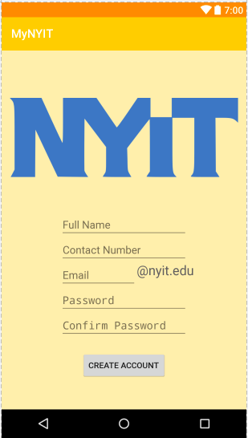
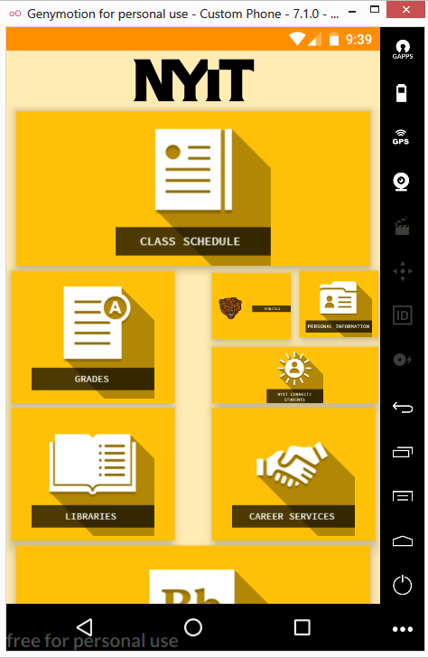
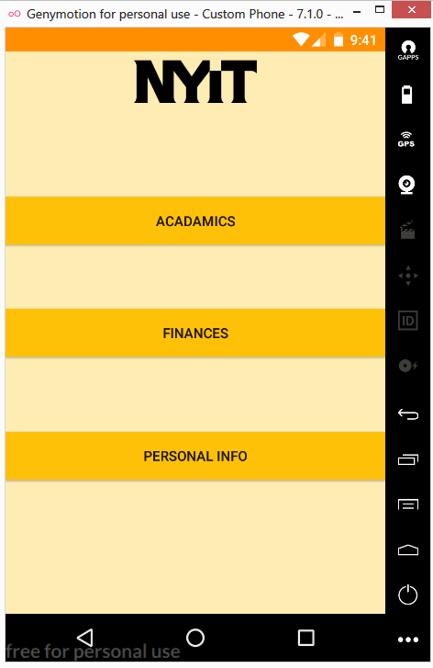
PROJECT IMPLEMENTATION

Slide 9
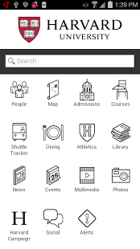
LITERATURE SURVEY
LITERATURE SURVEY
Harvard University
The Harvard Mobile app is a University-wide initiative to improve the mobile experience of students, faculty, staff, visitors, and neighbors who interact with Harvard’s campus and community.
The features of Harvard University are divided into different modules such as PEOPLE ,ADMISSIONS,COURSES,MAPS, SHUTTLE TRACKER , DINNING, ATHLETICS, LIBRARY, NEWS, EVENTS, ,MULTIMEDIA , PHOTOS, SOCIAL,SHARE, ALERTS, HARVARD CAMPAIGN.

Slide 10
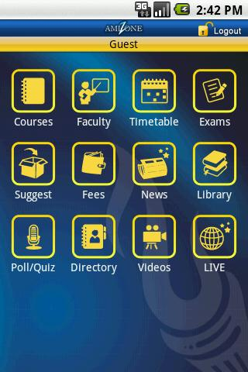
LITERATURE SURVEY (CONTD..)
Amity University
Amity University is one of the most hi-tech Universities in the world now launches its New App with additional features. Now Prospective parents and Students can get Information about Amity University and Programs offered, take Amity Online career test, download amity application form and prospectus, and more on Android devices.
The Amity mobile apps provided different features in mobile application. It includes ADMISSIONS in which it allows us to download Application Form and provide Offline forms for sales centers as well as guidelines for Admission Prospectus, Scholarships, and Education Loans. Also app includes icon for PROGRAMS which is offered by university. The icons like CAREER TEST, NEWS AND EVENTS, MAPS AND DIRECTIONS FOR AMITY CAMPUSES, DIRECTORY gives all the campus and faculty information according to user requirements.

Slide 11
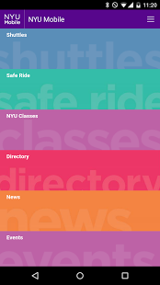
LITERATURE SURVEY (CONTD..)
New York University
NYU Mobile allows you to: Search for jobs on CareerNet, Search the campus map, Check bus routes, Find contact information in the NYU Directory, Check the University events calendar, Browse University news. Schedule Safe Ride transportation, Receive University Info Alerts, including push notifications, dining services information
Student/faculty portal for class assignments, academic document, and grades i.e. NYU CLASSES Provides portal for student administrative information, class registration process, fee information, course details with class schedule, student loan information in ALBERT NYU GUIDE app is a sub app of NYU MOBILE which is made for extra curriculum activity such as events, news, and campus life for student, Student social life.

Slide 12
EXISTING SYSTEM
The college information and notifications are currently viewed through only official website. It is difficult to check the notifications through mobile phones and the notifications can only get by accessing the website. Authors and Affiliations

Slide 13
PROPOSED SYSTEM
We are introducing my.NYIT the android application software. The my.NYIT app is Sleek, distinctive, clean User Interface app enlightens user to view all your academics information just where you want it when you want. This app is useful for users like parents, faculties and student either from New York Institute of Technology or applicant. This app gives the total solution to everyone.

Slide 14
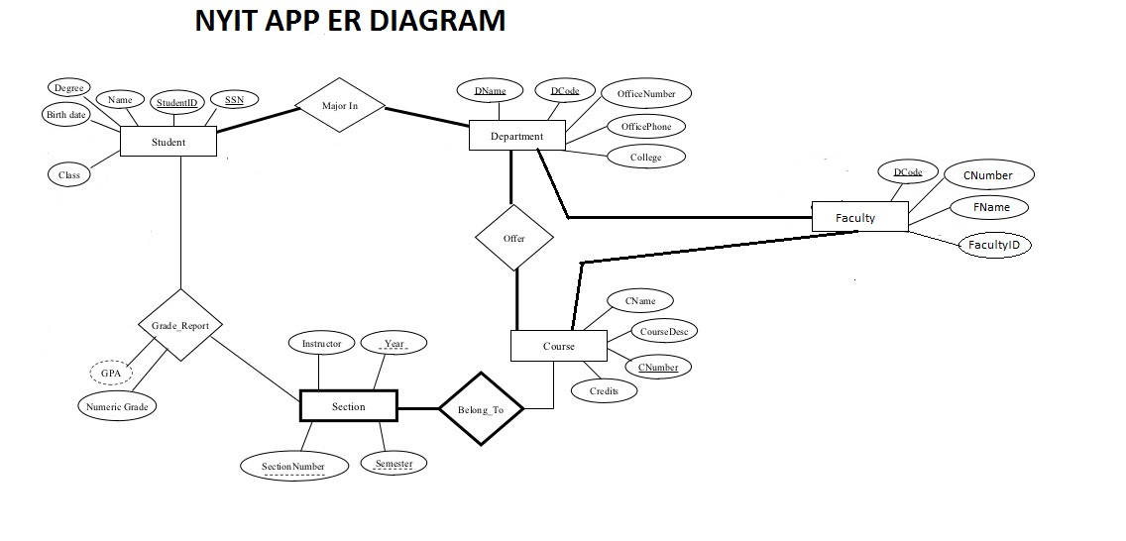
PROJECT ER DIAGRAM

Slide 15
CONCLUSION
The era of mobile technology opens the windows to the android app. The websites are vanishing and the smart phones are emerging .It is time to change from conventional websites to apps which has become the part of our daily routine. We are introducing my.NYIT the android application software which the app version of our University Website.

Slide 16
FUTURE SCOPE
Currently the Android application works as an offline application which only allows access data from the application .Future the application will be working as online application which includes the features like bus tracking system, which allows the parents to track the bus and this feature is very helpful as it emphasis on security .
The registered NYIT Students user would be provided a chat on facility for communication. Application also integrate advanced students teachers communication for better utilization of the application .
Parents, teachers communication may also be developed. Attendance percentage calculator can be introduced. Assignments can be submitted through online, and mailed etc. .Online Library system can be introduced

Slide 17
THANK YOU

